Slide 1
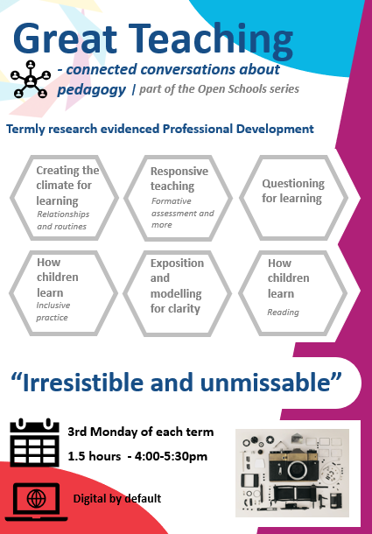
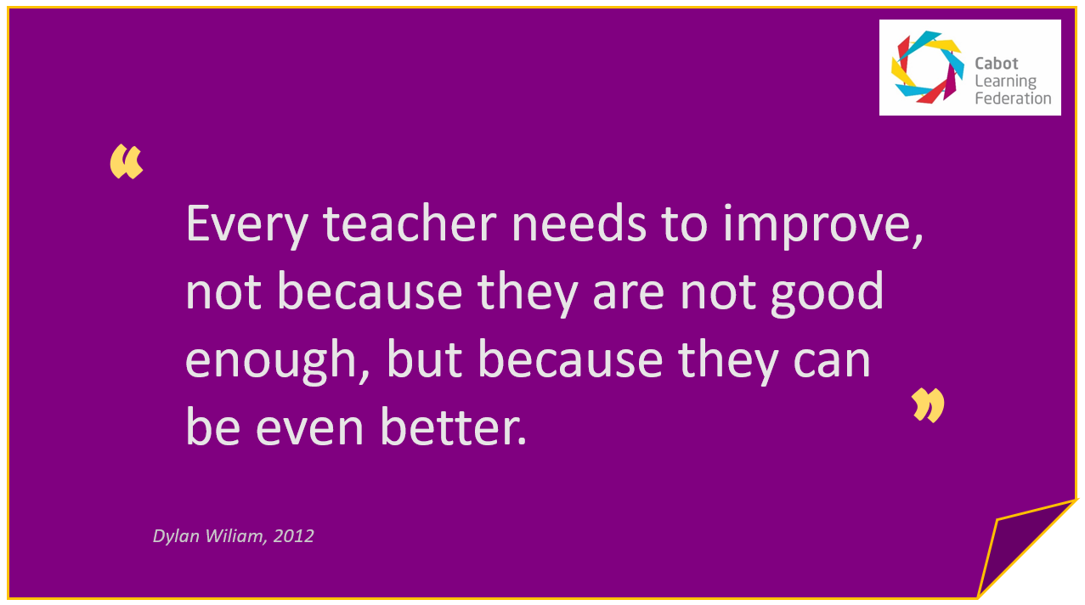
Great Teaching Session 3
Questioning for learning
17th January 2022

Slide 3
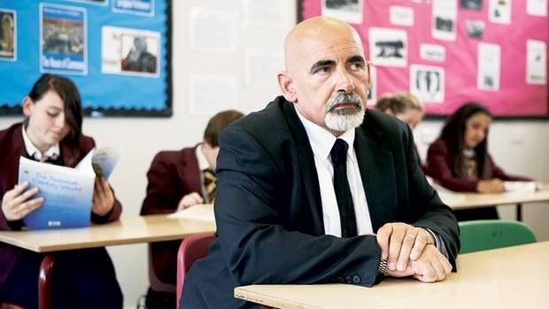
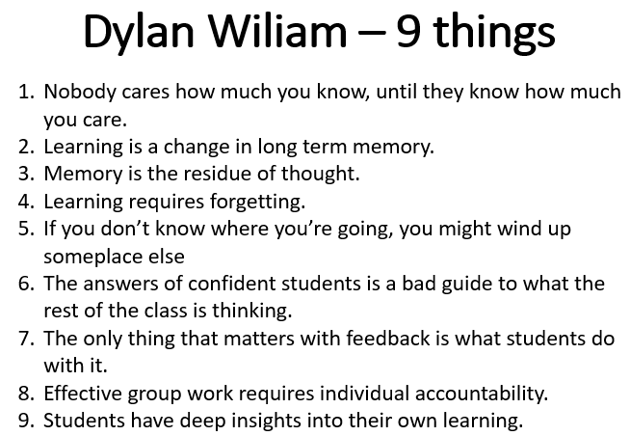
Flash read| What do you make of these 9 things?

Slide 4
Investment in Professional Development |For All
Professional Development
Changes within teacher
Enacted through teaching
Changes within pupil
Pupil performance (achievement)

Slide 5
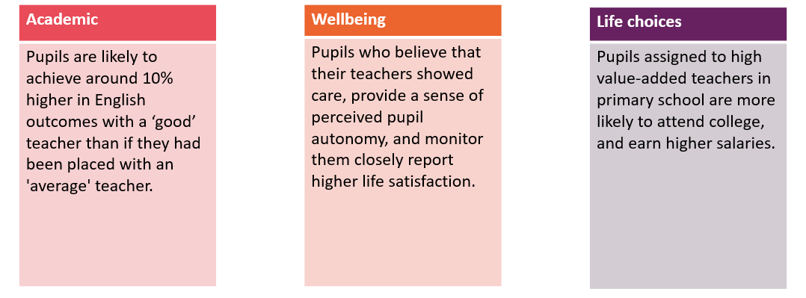
The impact of our teams |The whole child

Slide 6
Disadvantage first and even over …
O
“… ensuring that everyone has a fair chance to make the most of their capacities and their lives.”

Slide 7
Asking ourselves what and why and how?
How does our relentless focus on curriculum, pedagogy and assessment impact on our 12,500 children?
Why this, why now? Curriculum
Why this, like this?
Pedagogy
Why this, what next? Assessment
Stepping forward
Filling their backpacks
Learning which lasts

Slide 8
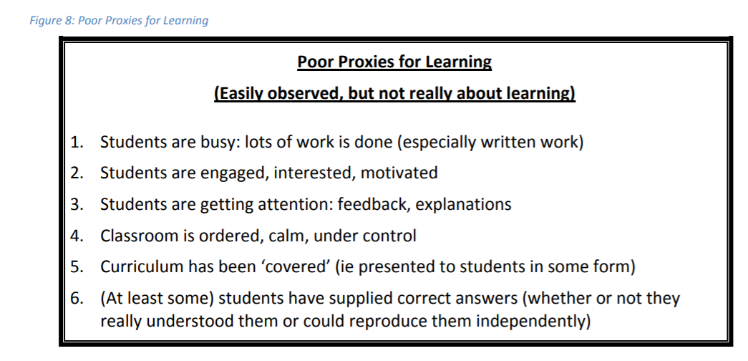
Poor proxies for learning| Prof Coe

Slide 9
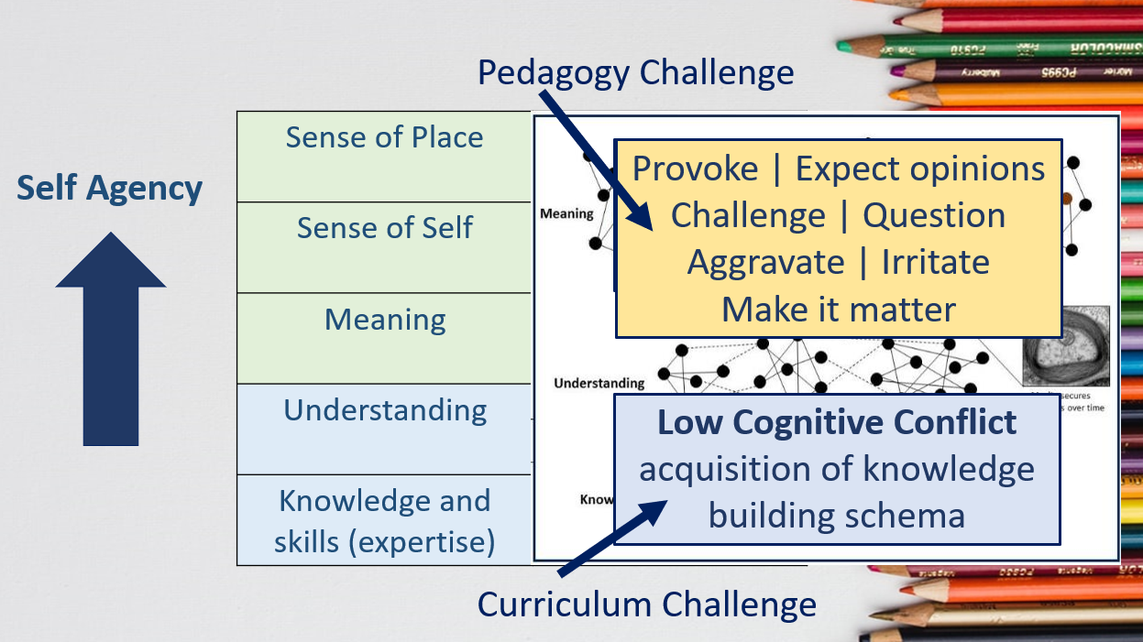
Provoke| Top right box teaching

Slide 11
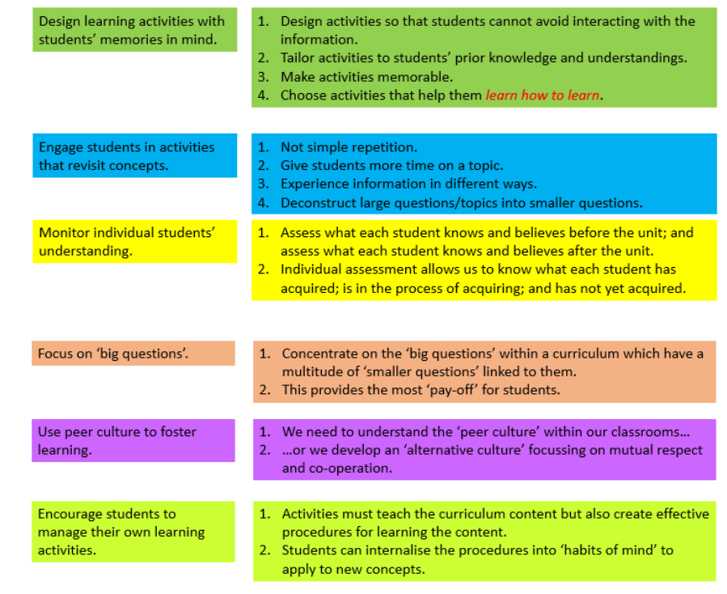
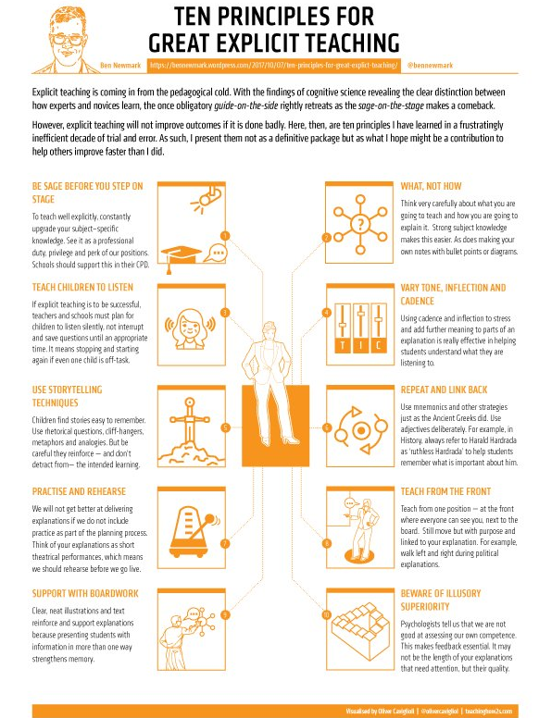
2001 2021
https://bennewmark.wordpress.com/2017/10/07/ten-principles-for-great-explict-teaching/

Slide 12
Revisiting the periodic table| Questioning

Slide 13
Fertile questions|Are you asking the right questions? Are you listening for the replies?
The word "curriculum" derives, ultimately, from a word meaning "a route of a race".
A curriculum worthy of the name should, therefore, take you on a journey from A to B; it shouldn’t be a collection of topics, texts and historical periods that you encounter during your time in school.

Slide 14
Fertile questions|Are you asking the right questions? Are you listening for the replies?
Be open There should be more than one possible answer to the question. This is not to say that some answers to it won’t be wrong, but it should be more complex than a simple yes or no.
Be undermining Misconceptions should be challenged by answering this question. It should make the pupil think in a new way about the topic and go beyond their everyday knowledge.
Be rich It should be based on powerful knowledge that needs to be researched and thought about from multiple angles.
Be connected There should be links to different parts of the discipline, as well as the potential to connect to their everyday knowledge. The fertile question may be a good opportunity to show the complexities of our subject and the fact that no topic stands in isolation just as no lesson does.
Be charged The question is likely to have an ethical dimension that deals with rights and wrongs, human rights or difficult decisions.
Be practical It needs to be within the ability of pupils to get hold of the information they need to answer the question. This information might well come from the teacher. But then you need to ensure that you can get hold of the information.

Slide 15
Fertile questions|Are you asking the right questions? Are you listening for the replies?
Be open There should be more than one possible answer to the question. This is not to say that some answers to it won’t be wrong, but it should be more complex than a simple yes or no.
Be undermining Misconceptions should be challenged by answering this question. It should make the pupil think in a new way about the topic and go beyond their everyday knowledge.
Be rich It should be based on powerful knowledge that needs to be researched and thought about from multiple angles.
Be connected There should be links to different parts of the discipline, as well as the potential to connect to their everyday knowledge. The fertile question may be a good opportunity to show the complexities of our subject and the fact that no topic stands in isolation just as no lesson does.
Be charged The question is likely to have an ethical dimension that deals with rights and wrongs, human rights or difficult decisions.
Be practical It needs to be within the ability of pupils to get hold of the information they need to answer the question. This information might well come from the teacher. But then you need to ensure that you can get hold of the information.

Slide 16
Fertile questions|Are you asking the right questions? Are you listening for the replies?
Be open There should be more than one possible answer to the question. This is not to say that some answers to it won’t be wrong, but it should be more complex than a simple yes or no.
Be undermining Misconceptions should be challenged by answering this question. It should make the pupil think in a new way about the topic and go beyond their everyday knowledge.
Be rich It should be based on powerful knowledge that needs to be researched and thought about from multiple angles.
Be connected There should be links to different parts of the discipline, as well as the potential to connect to their everyday knowledge. The fertile question may be a good opportunity to show the complexities of our subject and the fact that no topic stands in isolation just as no lesson does.
Be charged The question is likely to have an ethical dimension that deals with rights and wrongs, human rights or difficult decisions.
Be practical It needs to be within the ability of pupils to get hold of the information they need to answer the question. This information might well come from the teacher. But then you need to ensure that you can get hold of the information.

Slide 17
https://impact.chartered.college/article/doherty-skilful-questioning-beating-heart-pedagogy/

Slide 18
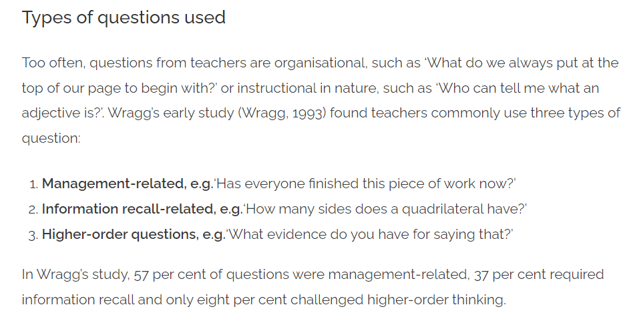
Skilful Questioning | The beating heart

Slide 19
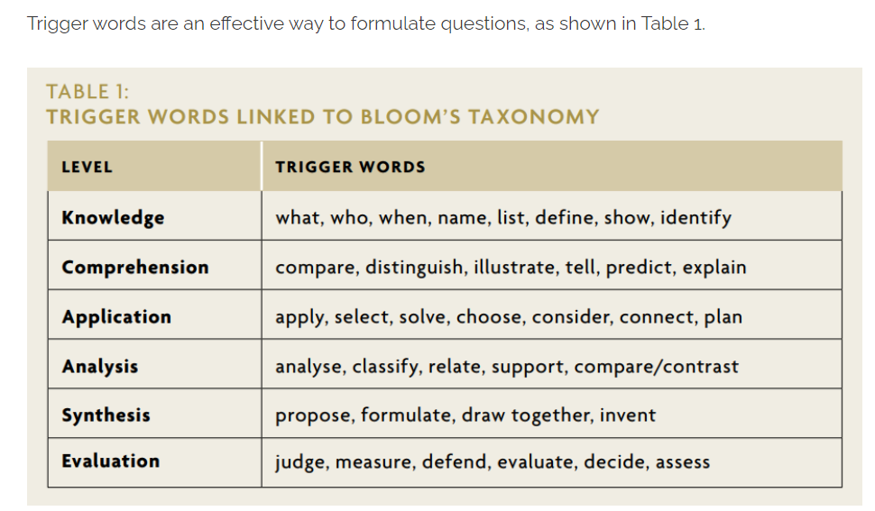
Skilful Questioning | The beating heart

Slide 20
Effective questioning | Looking at the research

Slide 21
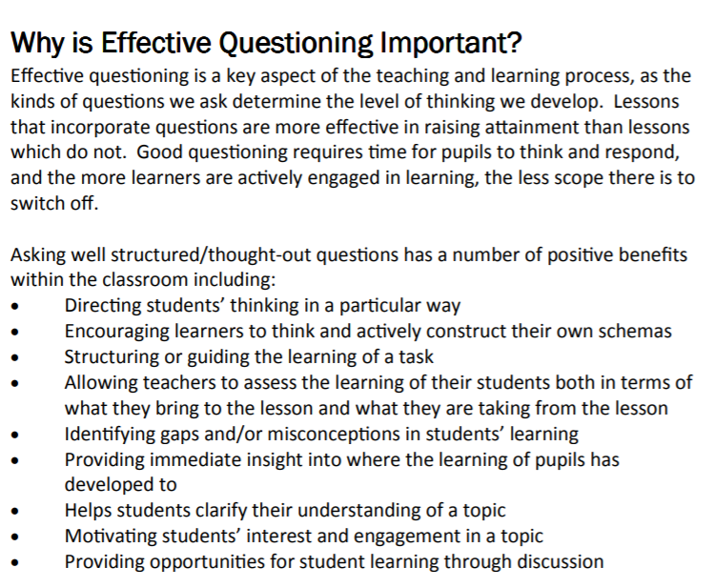
Effective questioning | Looking at the research

Slide 22
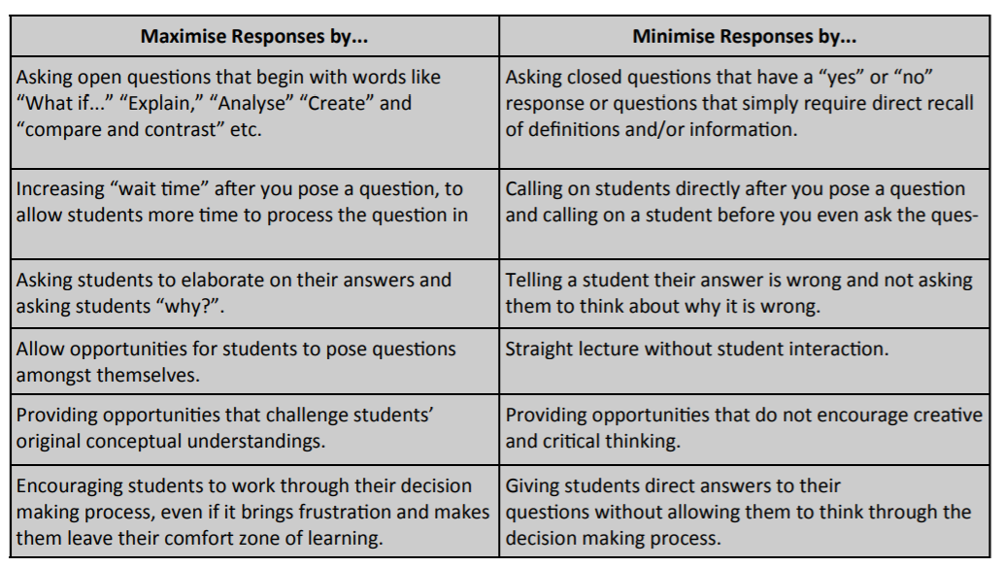

Slide 23
Questioning |Ambition video reflections

Slide 24
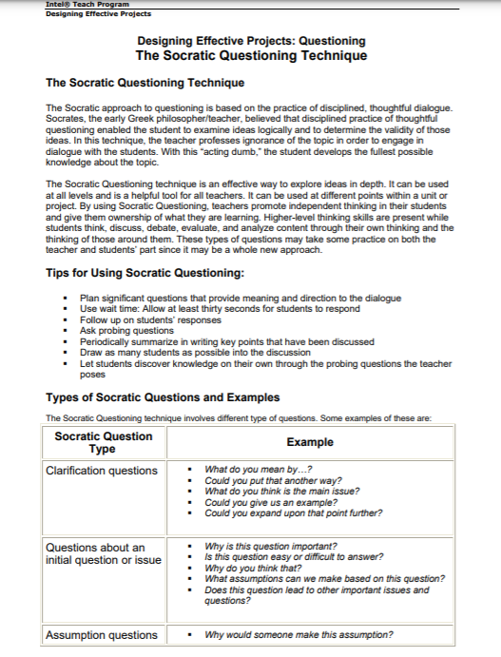
Socratic questioning | Looking at the research

Slide 25
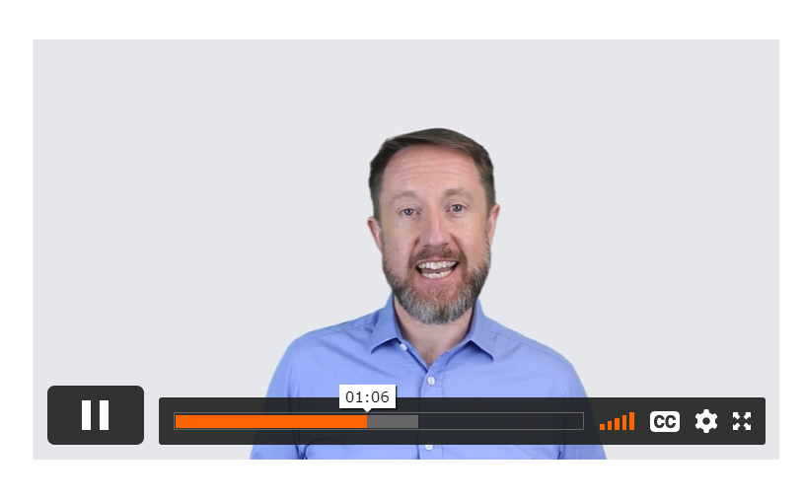
Effective questioning | Looking at the research
https://evidencebased.education/element-videos/

Slide 26
Effective questioning |Learning across the trust

Slide 27
Conclusions |Effective questioning
Plan for questioning as a key part of your pedagogy.
Questioning serves to promote learning and provide assessment information.
High quality questions can make a lesson.
The reverse is even more true and even more common.

Slide 28
Reflective questions |Questioning for Learning

Slide 29
Key takeaways and further reading

