Slide 1
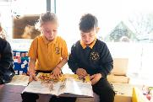
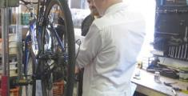
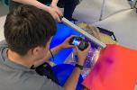
Through the eyes of our learners
“It’s easy to forget that there’s really only one person who gets a holistic view of a child’s education, and that is the child.” TES editorial 8th November 2019
Notes:
Have you turned your computer sound on?

Slide 2
Agenda | This session of PD and Learning
Addressing disadvantage by reviewing the reading requirements made of students across all subjects
The aims of this session are:
to consider the complexity of the reading process as well as the barriers which potentially hinder the ability of students to access text, particularly those experiencing disadvantage
to listen to the experiences of students at two CLF schools, following a typical school day and consider how we can remove the barriers that they face
to discuss and share what we currently do which has a positive impact on the removal of barriers for these students; to consider whether any of the strategies discussed can be adopted and/or adapted for use in our own setting from Term 2

Slide 3
Agenda | This session of PD and Learning
Addressing disadvantage by reviewing the reading requirements made of students across all subjects
Your facilitators today
School Improvement Team: Rachael Symons, Reading Lead (3-19) and Primary English Lead
Principals: Chris Barrett; Jon Jones; Jenny Harvey
CLF Institute: Evelyn Fudge
Notes:
Session 1
Introductions, please can principals keep their cameras on throughout the session

Slide 4
Agenda | This session of PD and Learning
Addressing disadvantage by reviewing the reading requirements made of students across all subjects
Your facilitators today
School Improvement Team: Rachael Symons, Reading Lead (3-19) and Primary English Lead
Principals: Tony Searle; Sam Hodder; Ian Garforth
CLF Institute: Evelyn Fudge
Notes:
Session 2
Introductions, please can principals keep their cameras on throughout the session

Slide 5
Welcome| How to get the most from this Professional Development
Introductions
Function | When to use it
Chat function | When you see this icon. Be ready to contribute at ANY time.
Using mute | When you are listening and not actively contributing to the discussion.
Using video | When requested to put your video on by the facilitators. Be ready to have your video on at ANY time.

Slide 6
We are all learners | Invest in Professional Development
Be
curious
Be a learner
Be considerate
Be professional
Be connected
Be together

Slide 7
Reading requirements and addressing disadvantage
Reading: the complexity of the process
Reading: the barriers to access
Reading demands of a school day
Current strategies; what works; what do we need to do?

Slide 8
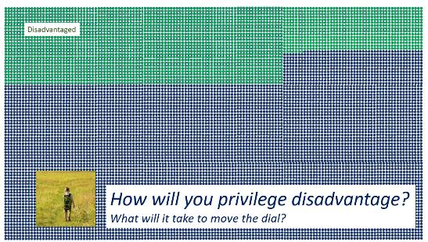
Why do we exist? | Our Core Purpose across our trust
Our collective endeavour
& shared responsibility
Notes:
In this session we will consider how we actively plan to enable those experiencing disadvantage to access text within our subject at secondary and across all subjects at primary

Slide 9
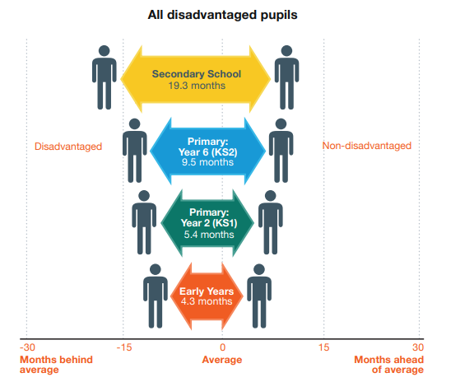
The difference we can make| Moving the dial
Look at the following data from the EEF (2017)
What do you notice about the trend between disadvantaged and non-disadvantaged pupils as they go through school?
Why might this data important for teachers to consider?
Education Endowment Foundation (2017) Attainment Gap Report

Slide 10
Reading requirements and addressing disadvantage
Reading: the complexity of the process
Reading: the barriers to access
Reading demands of a school day
Current strategies; what works; what do we need to do?

Slide 11
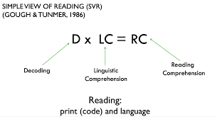
The Complexity of Reading| Scarborough’s Reading Rope
Notes:
You may well be familiar with the image on the bottom right of your screen – the simple view of reading. G & T 1986 put forward the theory that reading comprehension is the factor of decoding and linguistic comprehension – reading comprehension cannot occur if either one of these factors is zero.
Impact: Rose Review 2006, phonics …
Scarborough and others since, whist finding the simple view incredibly useful, also found it to be too simple …

Slide 12
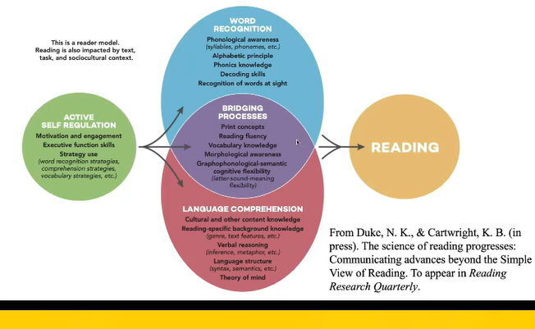
The Complexity of Reading| The Active View of Reading
Notes:
Highlights (there is a link to the original paper in your journal on p5 of the reading requirements section
The overlap between word recognition and language comprehension – these are the bridging processes
The impact of self-regulation and students capacity and ability to do this
The fact that this is just a reader model – the text will also have an impact, as will the task and the sociocultural context – there’s a lot to consider when planning any reading within your lesson. The link to the full article is on page 5 of the reading requirements section of your PD journal

Slide 13
Reading requirements and addressing disadvantage
Reading: the complexity of the process
Reading: the barriers to access
Reading demands of a school day
Current strategies; what works; what do we need to do?

Slide 14
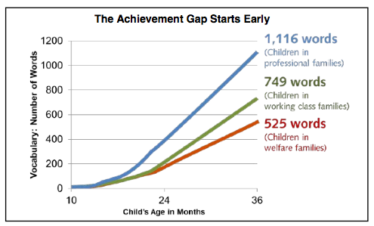
The Achievement Gap| 1000 words research
A 3 year old from a disadvantaged background knows approximately 525 words
> In comparison their 3 year old peers from non-disadvantaged backgrounds know approximately 53% more words (1,116 words)
Graph adapted from Hart, B. & Risley, T. R. (1995). Meaningful Difference in the Everyday Experiences of Young Children

Slide 15
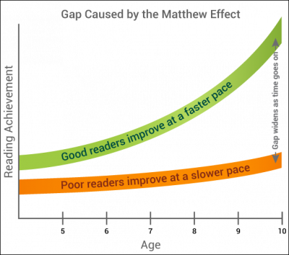
The Matthew Effect| Cumulative disadvantage
Stanovich (1986) referred to the ‘Matthew Effect’ in education: ‘the rich get richer and poor get poorer.’
Notes:
Before I go on to the next slide, please consider what you think are the barriers to students being able to successfully access text – think about specific students that you work with who struggle to access texts, what are their particular barriers.
The list on the next slide is not exhaustive – it does not include for example, having English as an Additional Language

Slide 16
Barriers to successfully accessing text
Reading Barrier Potential Indicator in the classroom
Vocabulary uses limited vocabulary in speech and/or writing
Background knowledge unable to make links between text and experiences
Comprehension monitoring difficulty recognising misconceptions or gaps in their knowledge
Oral expression difficulty organising verbal expression and/or limited engagement in class talk
Figurative language difficulty understanding layers of meaning, metaphors etc
Narrative skills difficulty following sequences
Grammatical development difficulty following complex sentences
Verbal reasoning difficulty identifying words that have a similar or opposite meanings
Inferencing difficulty making inferences to cohere and elaborate upon what has been read
Verbal working memory difficulty following multi-step instructions
Motivation to read dislikes reading, struggles to read and understand, low reading miles
Notes:
As you can see, each barrier is presented with how this might present itself in the classroom – this barrier may present itself differently for different students and we need to be alert to that.
I have highlighted the top two: vocabulary and background knowledge because, in my view, they impact on everything else.
We have to know our students really well, we have to know where their gaps are, we need to know how best to support them

Slide 17
Pre-discussion reading questions to prompt your thinking
https://www.sec-ed.co.uk/best-practice/every-teacher-is-a-teacher-of-literacy-teaching-literacy-across-the-curriculum-part-1/
“To be literate,” Kassam goes on, “is to gain self-confidence. To be literate is to become self-assertive. Literacy enables people to read their own world and to write their own history. Literacy provides access to written knowledge and knowledge is power. In a nutshell, literacy empowers.”
as George Sampson said (as long ago as 1922 in his book English for the English), “Every teacher is a teacher of English because every teacher is a teacher in English.”
Notes:
You now have 5 minutes to read the article, I will put it up on the screen here too. Whilst it is aimed at secondary teachers, there is so much here that resonates with primary teachers needing to be experts in all areas of the curriculum
Questions for Principals:
How do you ensure the accessibility of texts within your setting?
If you use reading age assessments, how do you ensure that your teachers know what information they are being given about each individual student? Do your teachers know what to do with this information – do they know how to support the development of literacy skills for students whose data indicates that they are below ARE?

Slide 18
Progression through the PD| Stepping through the sessions
Reading: the complexity of the process
Reading: the barriers to access
Reading demands of a school day
Current strategies; what works; what do we need to do?

Slide 19
Case study: Evergreen Primary Academy
Reading Opportunities:
Early Morning Work (DERIC)
Whole Class Reading Session
Vocabulary (herbivore)
BREAK
Maths (What? Why? How?)
Warm Up video – with subtitles
LUNCH
Silent reading
Preparation for assembly – Marvin Rees biography
Notes:
Would like to thank EPA and CAB for allowing me to spend a day in Y4 and Y8 respectively, particular thanks must go to the teachers whose lessons I spent a long time in. Biggest thanks go to the students – they were superstars.
Schools are busy places and so the only places that I could find to film, were resource rooms – apologies for the backgrounds in both cases!
Talk through some of the opportunities.
Next you will see short extracts from interviews with students.
Please can you listen to each extract and make notes of the key messages that the children are conveying.

Slide 20
Notes:
To 5:25

Slide 21
Notes:
To 6:30

Slide 22
Notes:
To 7:30

Slide 23
Notes:
To 10:00
Precise praise from the teacher means that you know exactly what you did well and so you can do it again

Slide 24
Notes:
To 14:05

Slide 25
Notes:
To 20:30

Slide 26
Key messages
Background knowledge is really helpful because you can build on what you already know. Learning new things is exciting too because you get to learn from your mistakes
Having the opportunity to challenge yourself is good – so long as it’s not too hard!
Being able to choose what you read makes it more likely you’ll enjoy it and you’ll read more
Precise praise from the teacher means that you know exactly what you did well and so you can do it again
Other students reading aloud is ok but it’s not always easy to hear what they are saying – when the teacher reads aloud, they are clear, their pace is just right and they use expression which makes it easier to understand the text: teacher modelling is key
Knowing students is really important – some are happy and confident reading aloud to the class, others have felt embarrassed in the past and worry about making mistakes

Slide 27
Case study: City Academy
Reading opportunities:
Learning Family
Maths
Urdu
Computer Science
Geography
Design and Technology
End of the day - interview

Slide 28
Through the eyes of a student at secondary …
Provide a stock of books, in classrooms for students who, for whatever reason do not bring their reading book to school

Slide 29
Notes:
To 2:30

Slide 30
Notes:
To 6:48

Slide 31
Notes:
To 8:50

Slide 32
Notes:
To 12:35

Slide 33
Notes:
To 15:05

Slide 34
Notes:
To 16:55

Slide 35
Notes:
To 18:40

Slide 36
Notes:
To 19:30

Slide 37
Key messages
Clarity is key when teaching, especially when teaching new concepts
It is useful to talk, repeat and discuss ideas, concepts and new knowledge before writing it down
Enabling students to read aloud (to themselves) questions allows them to hear their own voice, it enables them to focus on how best to answer the questions
Teachers explaining and using subject specific vocabulary supports students to understand it and use it themselves
Question: how conscious are we of those tier 2 words which we expect and assume students know, understand and can use to communicate either verbally or in writing?
Choice is empowering, it supports students to think and it enables them to have a voice
Teachers reading instructions aloud, is really helpful, especially to those students who are EAL or if they struggle with their reading
Teachers reading to students is a good thing – this might be the only time they are read to
Teachers should ask and support struggling readers to read aloud – if they only ask the ‘fast’ readers, the slower readers will never speed up.
If we only ask those students who we know, know, those who struggle will always struggle.

Slide 38
Progression through the PD| Stepping through the sessions
Introduction
Discussion 1
Case Study and reflections
Group discussion
Notes:
Principals:
How do you empower your teachers to develop the literacy skills of all students within their classes?

Slide 39
34
Reflection | The impact of this PD | From knowing to doing
What impact will this have on your teaching?
What impact will this have on your pupils?
What is your main takeaway from this session?
Notes:
You now have … minutes in breakout groups to reflect and consider these three questions.
Principals will be asked to feedback from their groups and if there is time, others will be asked to contribute too.
Please use the chat function to share your thoughts and suggestions

Slide 40
Thank you for your contributions

