Slide 1
Bridge to the Future – Part Two October Conference 2021
Professional Services and Professional Development
Steve Taylor
Chief Executive Officer
Cabot Learning Federation

Slide 2
How are our schools supported to perform well?
Corporate Services
Finance
HR
ICT
Executive Leadership
School Improvement & CPD

Slide 3
How are our schools supported to perform well?
Corporate Services
Finance
HR
ICT
Executive Leadership
School Improvement & CPD
Professional Services

Slide 4
CLF Educators’
Equivalence for Professional Services
Continuum of development for all staff
Pendulum in & out of whole CLF PD
Networks
Department-based PD
Individual self-study
Specialist courses
Cascading back into teams
Continuous improvement for raised standards
Notes:
Why? Continuously improve standards
What? Professional development to enable every member of staff to (put simply) do their work incrementally a bit better – so that they are more efficient/effective/deliver continuously better output, i.e. improved standard of the work, whatever it is
In each of our areas the WHAT will be different, and the design and delivery of deliberate PD programmes will be in context of staff and their roles/work.
Requisite Conditions? HEART values HIGH EXPECTATIONS – commitment from all staff to deliver the best possible quality of work
Culture of praise for continuing learning and continuous improvement – individuals and teams
Culture of trust for staff to self-evaluate accurately and engage positively with identifying and improving areas of own practice

Slide 5
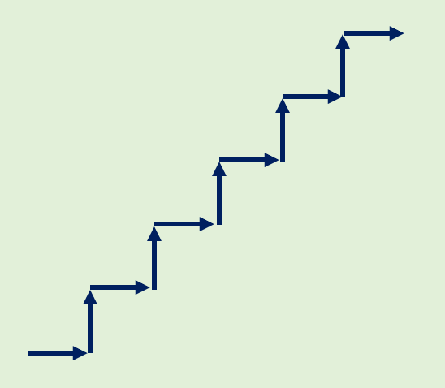
Strategic Plan 2021-2022
What?
Equivalence for Professional Services
Continuum of development for all staff
Pendulum in & out of whole CLF PD
Networks
Department-based PD
Individual self-study
Specialist courses
Cascading back into teams
Continuous improvement for raised standards
Standards
How?
Professional
Development
“our expectation of the acceptable standard is linked to the quality of professional development”
There is a synergy that exists between improving our standards and outstanding professional development

Slide 6
What’s the difference between
Professional Development,
Training,
Personal Development?
encompasses but goes beyond training
learning & enhancing knowledge, understanding & skills specific to your occupation
specialist work
progressing in a professional environment
may be career-stage: developing from novice to expert, developing ‘mastery’
applies to learning things that can be incrementally improved with experience and expert application in new & dynamic situations.
Professional Development
Personal Development
Training
Skills and behaviours that are taught and practised
Includes the necessary, e.g.
statutory and mandatory training
(e.g. Nimble modules, annual refresher);
basic IT skills
(competence in MS Office, CLF systems)
self-directed
for personal upskilling
following own interests
for enrichment
enhance wellbeing
nurture creativity
new opportunities
Notes:
Training – statutory knowledge (e.g. SG), mandatory behaviour expectations (e.g. Code of Conduct, H&S) and skills (e.g. IT)
PD
Personal Development – not very well defined (yet)! - enrichment, wellbeing, creativity
PD Platform – how we have used these headings to differentiate content (not very well yet!)

Slide 7
Professional Development in the CLF
For all staff
Protected regular time for professional development. This is your job.
Move from ‘one-off’ activity to programmes or continuous termly/yearly professional development (PD) plans
It’s not just going on a course.
Notes:
Why? Continuously improve standards
What? Professional development to enable every member of staff to (put simply) do their work incrementally a bit better – so that they are more efficient/effective/deliver continuously better output, i.e. improved standard of the work, whatever it is
In each of our areas the WHAT will be different, and the design and delivery of deliberate PD programmes will be in context of staff and their roles/work.
Requisite Conditions? HEART values HIGH EXPECTATIONS – commitment from all staff to deliver the best possible quality of work
Culture of praise for continuing learning and continuous improvement – individuals and teams
Culture of trust for staff to self-evaluate accurately and engage positively with identifying and improving areas of own practice

Slide 8
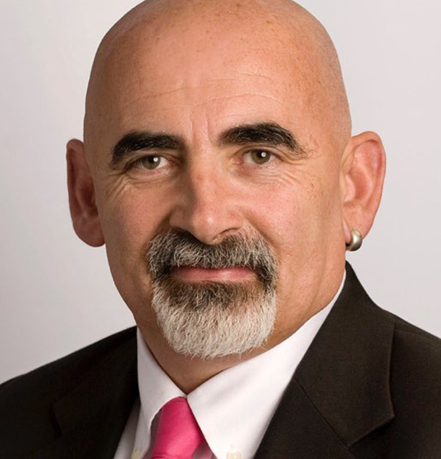
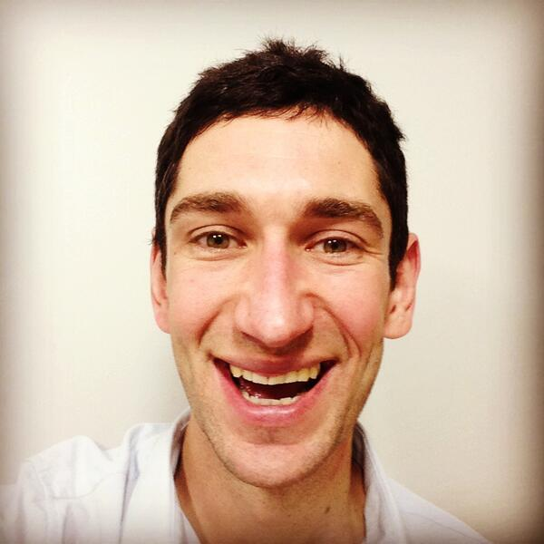
Characteristics of highly effective Professional Development in the CLF
Focus on improving outcomes (knowing > doing = action > impact)
Underpinned by best evidence and expertise
Collaborative
Expert challenge
Continuous and sustained
(Re-worked from DfE Standards for Professional Development)
“Teaching quality is important. It is arguably the greatest lever at our disposal for improving the life chances of the young people in our care, particularly for those from disadvantaged backgrounds”
Dylan Wiliam (2012)
“Every teacher needs to improve not because they are not good enough but because they can be even better”
Peps McCrea (2016)
Notes:
PD Platform

Slide 9
Characteristics of highly effective Professional Development in the CLF
Focus on improving outcomes (knowing > doing = action > impact)
Underpinned by best evidence and expertise
Collaborative
Expert challenge
Continuous and sustained
(Re-worked from DfE Standards for Professional Development)
“Teaching quality is important. It is arguably the greatest lever at our disposal for improving the life chances of the young people in our care, particularly for those from disadvantaged backgrounds”
Dylan Wiliam (2012)
“Every colleague needs to improve not because they are not good enough but because they can be even better”
Peps McCrea (2016)
Notes:
PD Platform

Slide 10
Characteristics of highly effective Professional Development in the CLF
Focus on improving outcomes (knowing > doing = action > impact)
Underpinned by best evidence and expertise
Collaborative
Expert challenge
Continuous and sustained
(Re-worked from DfE Standards for Professional Development)
“The quality of our work is important. It is arguably the greatest lever at our disposal for improving the life chances of the young people in our care, particularly for those from disadvantaged backgrounds”
Dylan Wiliam (2012)
“Every colleague needs to improve not because they are not good enough but because they can be even better”
Peps McCrea (2016)
Notes:
PD Platform

Slide 11
Delivering highly effective Professional Development in the CLF
What activities represent professional development?
Expert-led conversations about practice
Peer-to-peer development groups
Specialist knowledge enhancement
Specialist communities/professional networks
Whole-team PD
Observations and shadowing
Peer reviews
Instructional coaching/mentoring and action target setting
Reading (blogs, new research, professional journals, …)
Professional memberships (chartered associations, governing bodies, …)
External professional development courses/programmes
…
Not just going on a course...
Notes:
Variety of PD activities for developing teaching
Instructional coaching – currently the biggest ticket in education sector for teacher development and school improvement

Slide 12
What about the PD Platform?
https://develop.clf.uk/
Notes:
PD Platform

Slide 13
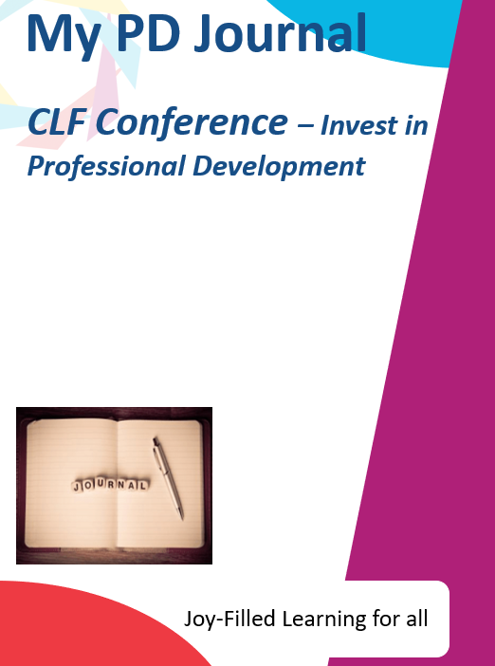
PD| Investing in your own Professional Development

Slide 14
PD| Investing in your own Professional Development
Effective notetaking is often the unsung hero of the workplace. It can help you capture ideas, learn new concepts, organize your thoughts, share information, and much more—but in order for your notes to be effective, you first have to learn the right notetaking strategies.
Focus on the Right Things
Less is More
Keep it Bold
Notes:
Effective notetaking is often the unsung hero of the workplace. It can help you capture ideas, learn new concepts, organize your thoughts, share information, and much more—but in order for your notes to be effective, you first have to learn the right notetaking strategies.
Focus on the Right Things
Your notes should not be a straight transcript of an entire meeting / workshop. Make sure you take down the main bullet points and any additional comments or questions you may have. The key is to focus on capturing the basic facts, key points and any questions that are raised in your mind.
Less is More
When it comes to notes, taking less is actually more. Take down keywords, skip unneeded words, or write down partial sentences. Once you are finished with the meeting / workshop, write up a full summary while the information is still fresh in your mind. This gives you the opportunity to fill in all the blanks, so when you look back you have everything you need.
Keep it Bold
While taking notes, make sure to highlight or bold the most important information. This allows you to more easily locate the important takeaways when skimming your notes later. If you are handwriting your notes, highlight or underline and If typing, use the highlighter, italicize, underline, and bold options to make your notes more effective.

Slide 15
PD| Investing in your own Professional Development
The following icons describe the expectations for each and every one of us. They outline the expected levels of engagement, professionalism and collaboration. These expectations link to our HEART values and are part of our trust wide investment in Professional Development, and they are designed for all of us and are here to stay!

