Slide 1
CLF Conference
Belonging
October 2021

Slide 2
We are all learners | Invest in Professional Development
Be
curious
Be a learner
Be considerate
Be professional
Be connected
Be together

Slide 3
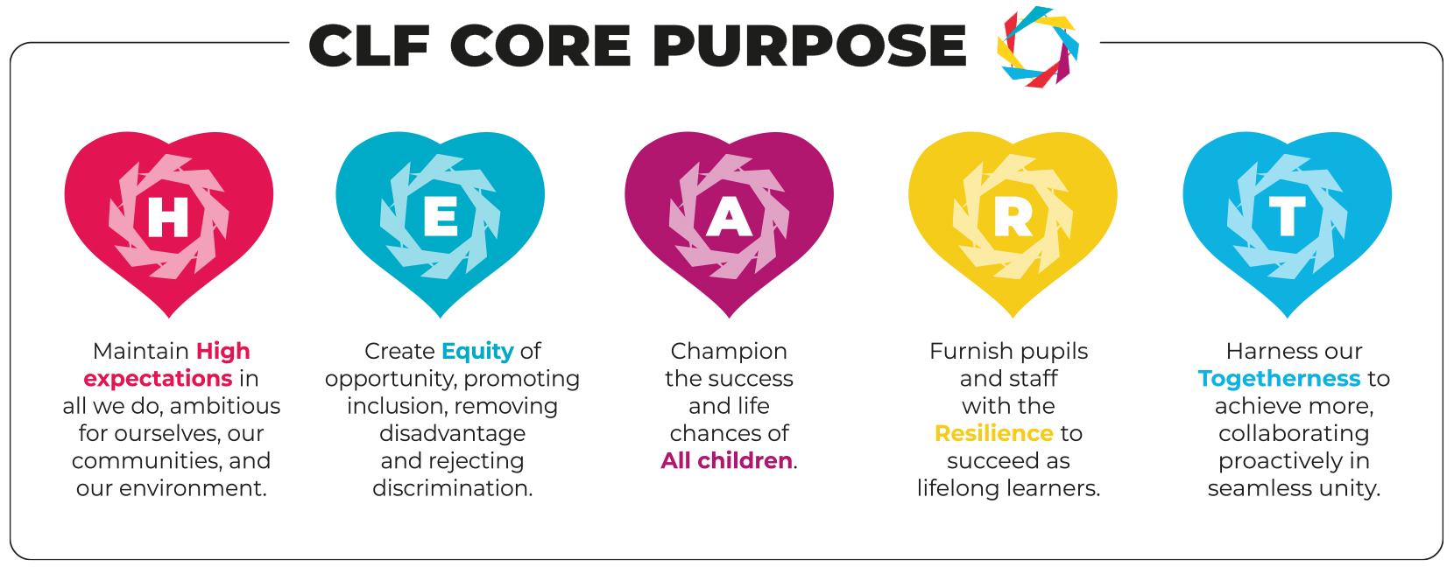
Our shared values | CLF Heart Values that underpin our work

Slide 4
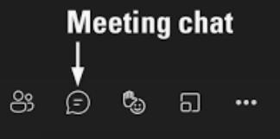
Welcome| How to get the most from this Professional Development
Introductions
Function | When to use it
Chat function | When you see this icon. Be ready to contribute at ANY time.
Using mute | When you are listening and not actively contributing to the discussion.
Using video | When requested to put your video on by the facilitators. Be ready to have your video on at ANY time.

Slide 5
Journal| Using your own PD journal

Slide 6
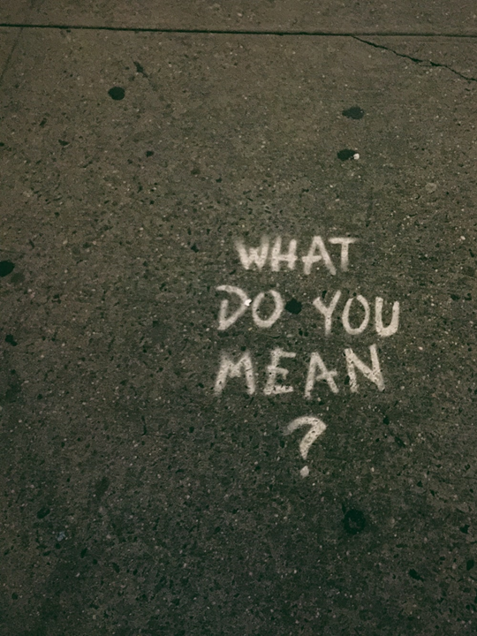
Check-in| Prepare for the content | Shared understanding
If there are items we run through or things you want to check and discuss, please ask.
Confidential and safe space for discussion.
Protect yourself and prepare for tough content and concepts in places.

Slide 7
Progression through the PD| Stepping through the sessions
Introduction
Discussion 1
Case Study and reflections
Group discussion

Slide 8
“
We belong in a bundle of life. Ubuntu says: a person is a person through other persons. It says: I am human because I belong
“
Archbishop Desmond Tutu
Notes:
Whilst it is important for us all to feel like we belong, for children it is particularly important as they learn and grow.
If the need to belong goes unmet, for some children, it can lead to the most extreme forms of violence and criminal and sexual exploitation. When you’re in a gang, you belong. When someone older is giving you gifts and attention and affection you belong – even if you belong also to their friends and associates.

Slide 9
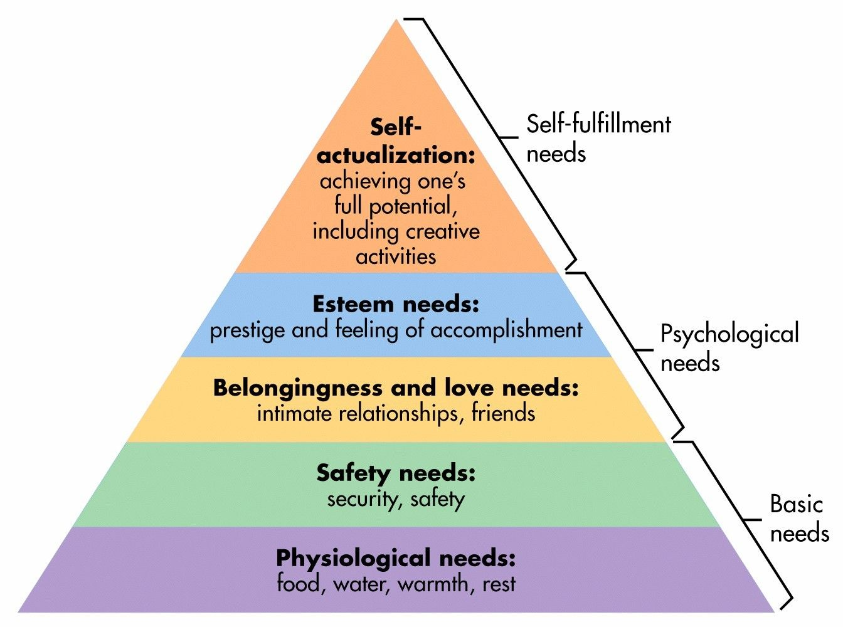
Belonging| Why it's important
Maslow felt it was of such importance that he placed belongingness just above physiological and safety needs, in his hierarchy of needs.
Sally Boardman, Life skills Groups
Notes:
Identities matter to us and a large part of construction of identity is about what is ‘self’ and what is ‘other’.
This level of identification underpins our social interaction, organisation and belief, sometimes in constructive ways and sometimes in ways which are damaging.
Creation of identity brings social connection and group membership; around and beyond this is a deeper and more instinctive need to belong.
A sense of belonging is crucial to our life satisfaction, happiness, mental and physical health and even longevity. It gives us a sense of purpose and meaning. Research has shown that loss of belonging has been associated with stress, illness and decreased wellbeing and depression
Kath to input into example.

Slide 10
“
Although we may think of, and treat relationships with one-another as the icing on the cake, they are actually the cake
“
Dr Dan Siegel
Notes:
Dr Siegel explains that we are not a singular noun but a plural verb. The “me” discovers meaning and happiness in life by belonging to a “we”.
We have the chance to create more inclusive settings where children (and their families) aspire to and meet our high expectations - with support.

Slide 11
Progression through the PD| Stepping through the sessions
Introduction
Discussion 1
Case Study and reflections
Group discussion

Slide 12
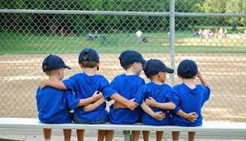
Belonging| How do I belong?
What gives you a sense of belonging at your academy / within your team / in your personal life?
How does this happen?
What makes you feel valued?
10 minute discussion in groups of 4/5
Notes:
Select one person to add comments in the chat for your group.

Slide 13
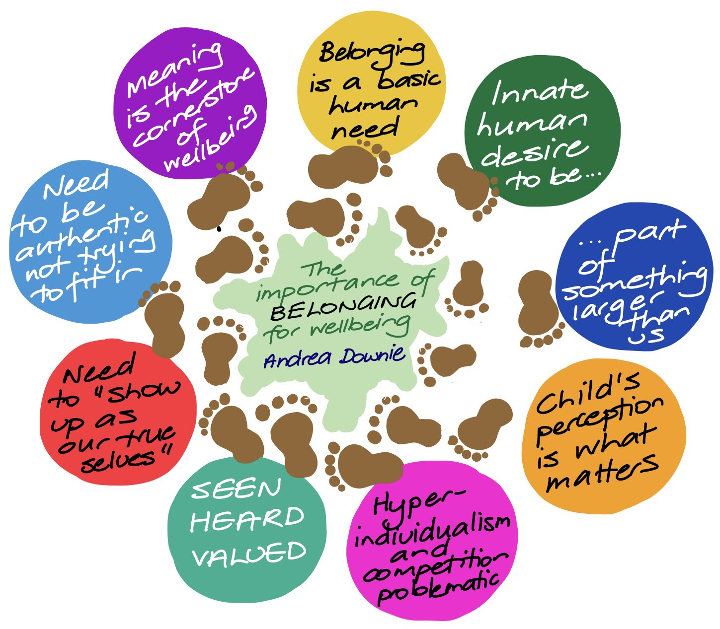
Belonging| How do I belong?
What gives you a sense of belonging at your academy / within your team?
How does this happen?
What makes you feel valued?

Slide 14
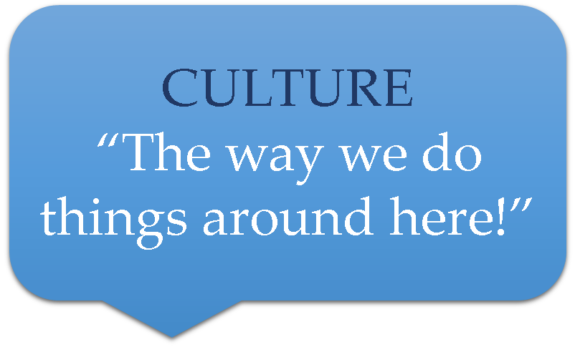
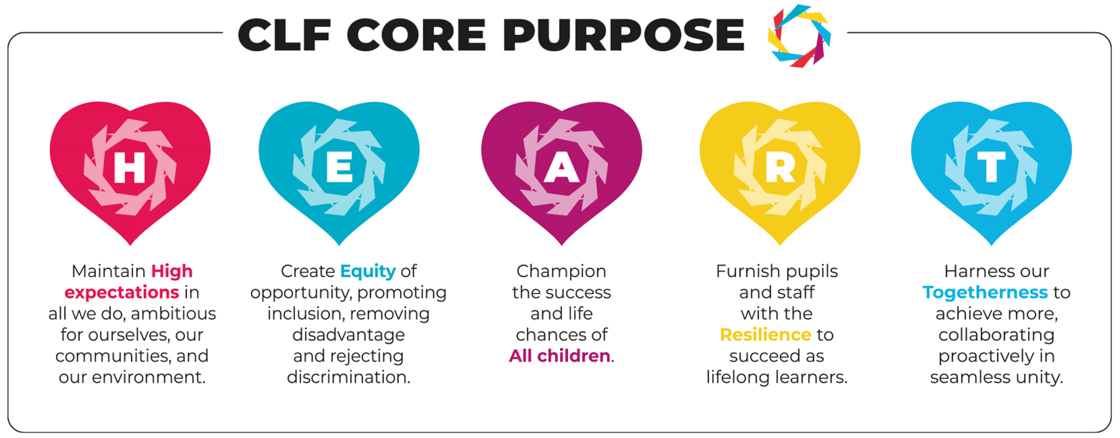
Belonging| How we create a sense of belonging (for children in our schools)
Notes:
We create a sense of belonging through systems, policies and behaviours.
From the uniforms we expect our children to wear, the learning families, teams and houses we establish, the way we respect each other and support children to do the same, through the images we use in classroom and displays, enrichment activities we offer, through to noticing and acknowledging when our colleagues or children do something well.
Our expectations, how we live and breath them, model them for our colleagues, children and families is the culture and ethos – when was the last time you reviewed these – how do your behaviours demonstrate the schools ethos and vision (and the CLFs)? What are your expectations of yourself?
Kath to provide some examples.

Slide 15
Belonging| How we create a sense of belonging (for children in our schools)
Notes:
Essentially what do, how we do it and the language we use creates a sense of belonging for our children, their families, our colleagues and ourselves.
We are either telling a child (and their family) they belong with our actions and choices, or we are telling them that they do not. It is our job as adults working with young people to ensure that they (and their families) know that they belong in our schools, and this is something we do with our language, with our tone, our manner, and our choices.

Slide 16
Progression through the PD| Stepping through the sessions
Introduction
Discussion 1
Case Study and reflections
Group discussion

Slide 17
Belonging| How can we create a sense of belonging?
Case Study 1
Anouk is one of 6 children 3 older and two younger (not all of them full siblings), she lives at home with her mum who is unable to find work as she has no qualifications and is currently being treated for depression. They have recently moved further away from school.
Anouk’s attendance is poor and there are behaviour concerns. She is working below age related expectations in reading, writing and maths. She often arrives without her reading book and forgets her PE kit. She doesn’t seem to eat much at lunch time and has few friends at school.
Drawing is something Anouk really enjoys and often does this instead of concentrating on the lesson or task at hand. She likes talking to adults and always has a story to tell.
Notes:
Read through the case study – what are your thoughts? What might you do?
An example:
When mum arrived late with Anouk for the fifth time in two weeks the receptionist asked mum whether there was anything they could do to help. Mum is initially confrontational but suddenly broke down in tears and explained that she had to use two buses to get to school and if one was late they missed the next. This is whilst also having to manage the two younger children.
The receptionist arranged for the family support worker to contact mum and they were able to help her apply for transport, this also helped her older children who were often also late to secondary school.
The receptionist / administrator put a note on the system and made sure the class teacher had seen it.
When it was parents evening the admin team made sure to contacted mum in advance to check bus times and booked her appointment for her at an appropriate time.

Slide 18
Belonging| How can we create a sense of belonging?
Case Study 2
Liam lives with his mum who has medical needs and he sometimes has to care for her. He has is responsible for taking his 3 siblings to school as well as doing a lot of the cleaning, cooking and shopping. He has trouble sleeping. He left secondary school with good grades but is not performing as well as expected at P16.
Liam has SEN needs and requires a readers and scribe in exams however his SEN need was only identified in Year 9. He isn’t very organised but actively participates in lessons and enjoys debate and discussion.
Following a survey of all students P16 found that Liam finds it useful to have a space to catch-up during free sessions and being provided with resources electronically (too much paper doesn’t help him).
He also recognised that for the scribe to be useful in exams they should be practiced at it and be able to write it the time allocated (he has experienced being give a scribe with a bad hand).
Notes:
Read through the case study – what are your thoughts? What might you do?
Post 16 have………

Slide 19
Progression through the PD| Stepping through the sessions
Introduction
Discussion 1
Case Study and reflections
Group discussion

Slide 20
Belonging| How can you create a sense of belonging?
What do I (we) already do to create a sense of belonging for families?
What could I (we) do as well as, instead of or better?
Why will this better support disadvantage learners?
15 minute discussion in groups of 4/5
Notes:
How do we create a sense of belonging not only for children and colleagues but parents and members of our wider communities?

Slide 21
Belonging| How can you create a sense of belonging?
What do I (we) already do to create a sense of belonging for families?
What could I (we) do as well as, instead of or better?
Why will this better support disadvantage learners?
Notes:
Be welcoming, put the child or family member before the work you are doing.
Check in – don’t assume a system or process has been deliberately ignored, ask the right questions to find the barriers or challenges (staff, parents, children).
Stay positive – use positive language not “why are you late” but “how are you, is everything ok as you are a little late” – pass on anything you learnt to the right colleague so they can provide further support.
See a child looking anxious / sitting alone / out of class / searching their bag / not eating – don’t walk by or assume someone else has already pick this up. Ask, find them the support they need – just noticing could make all the difference.

Slide 22
“
To feel a sense of belonging is to feel accepted, to feel seen and to feel included by a group of people, believing that we fit in, trusting that we will be protected by them. To not feel belonging is to experience the precarious and insecure sense of an outsider.
“
Owen Eastwood
Notes:
Academy leaders are considering how they can find out what children’s sense of belonging is in your academies. They will be considering how systems, policies and practices are positively or negatively impacting some children’s experience.
You can have an influence on how these are developed, through the behaviours you model, the way processes are adapted and improved within your area of expertise, how you use the environment you work in.
You can help parents feel like they belong in the language you use in communications, the way you greet them, how you support them to navigate the education system. You can make then feel seen, included and accepted.

Slide 23
Belonging| Key Take Aways
A smile
A hello, good morning, thank you, well done
Checking someone is ok (not just walking past)
Welcoming the interruption
“
We can all make a difference in the lives of others in need, because it is the most simple of gestures that make the most significant difference
“
Miya Yamanouchi
Notes:
Smiling, even when answering a phone, is infectious. It creates a sense of welcome, we are in this together.
Don’t walk past – check if the child is ok, don’t judge, offer them support, don’t take a negative response personally, alert an appropriate member of staff if you are concerned.
Arriving late – smile, welcome them, ask if everything is ok, share any information you get with the appropriate colleague.
We are interrupted all the time and this can be annoying and stressful – we are all in this together, look up and smile, acknowledge they are there. If you are not available let them know and agree when they can come back.
Leaving an assessment – tell them they worked hard, congratulate them for making it through.
Leaving the site – say goodbye (even if you are ignored!).
Upset parent, colleague or child – they need someone to listen, give them all of your attention, don’t be offended if they only way they can communicate is not in a the professional way you would, summarise what is wrong and provide assurance we will do our best to resolve it. Set expectations for response and follow up.

Slide 24
Reflection | The impact of this PD | From knowing to doing
What impact will this have on your practice?
What impact will this have on your families / pupils / colleagues?
What is your main takeaway from this session?
Notes:
For the last 5 minutes please use your journal to consider …
Don’t forget to share you CLF Stories or Autumn pictures. I have pasted the padlet links in the chat.

