Slide 1
CLF Conference
October 2021

Slide 2
Session title: Mental Health and Wellbeing; what can I do to support a positive culture?

Slide 3
Models for Great Teaching| Research for PD planning
Presenting information from a credible source
Modelling discussion
Modelling rehearsal
Wrapping up: compelling action

Slide 4
Discussion mode| Guidelines
Mode and purpose | Method | How to use it | How not to use it
Cold calling It is used to… Check understanding Help you clarify your own understanding Hear a wide range of views | Ask a question Give thinking time Name the person | Don’t put people on the spot It's not to catch people out Not to make people feel awkward

Slide 5
We are all learners | Invest in Professional Development
Be
curious
Be considerate
Be connected

Slide 6
We are all learners | Invest in Professional Development
Be
curious
Be a learner
Be considerate
Be professional
Be connected
Be together

Slide 7
Progression through the PD| Stepping through the sessions
Introduction
Case Studies (Julie and Alex)
Reflection: alone
Breakout groups: case studies
Feedback – cold calling.
Breakout groups: changing behaviours
Wrapping up: compelling action

Slide 8
Our shared values | CLF Heart Values that underpin our work

Slide 9
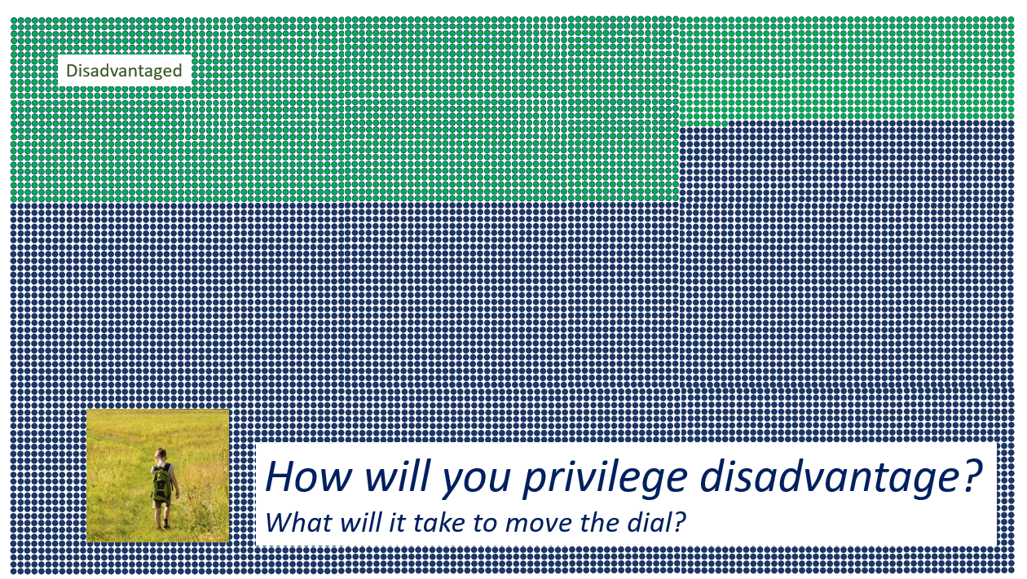
Why do we exist? | Our Core Purpose across our trust
Our collective endeavour
& shared responsibility

Slide 10
How do we lift things up?

Slide 11
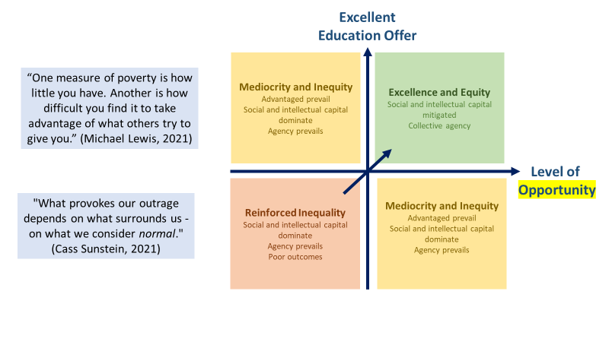

Slide 12
The stats
One in six school-aged children has a mental health problem
Pupils who have a mental health problem are more likely to be excluded from school than their peers.
Three our of four Children in Care have a mental health problem.
https://www.centreformentalhealth.org.uk/sites/default/files/2021-02/CYP%20mental%20health%20fact%20sheet%202021.pdf
https://www.gov.uk/government/publications/covid-19-mental-health-and-wellbeing-surveillance-report/2-important-findings-so-far

Slide 13
Mental Health
Children from racialised communities are less likely than their white peers to access traditional mental health services.

Slide 14
WHY? The Big Ask
The key findings of the interesting survey were;
71% of 9-17 yr. olds and 94% of 6-8 yr. olds are happy with their life overall, though 9% of 9-17 yr. olds don’t think they’ll have a better life than their parents.
Of those who are unhappy, 70% were unhappy with their mental health.
Girls are twice as likely to be unhappy with their mental health than boys and 52% of 9-17 yr. olds say having good mental health is one of their main aspirations.
80% of 9-17 yr. olds said they are happy with their family life but where children are unhappy with that, they are 9 times more likely to be unhappy with life overall.
57% of children from deprived areas said leaving school with a good education was one of their most important priorities.
https://educationhub.blog.gov.uk/2021/09/21/the-big-ask-survey-the-findings/

Slide 15
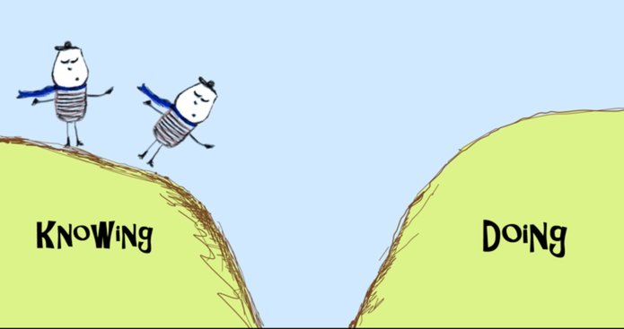
What are we doing?
Knowing
Doing

Slide 16
Our strategy
A CLF definition of Mental Health and wellbeing sits within clear guidance which shares our trust approach to signposting and support. |  | Staff regularly engage with the available MH&WB resources available in order to promote their positive MH&WB.
 | The MH lead role is effective, and has positive impact on MH&WB in every academy
CLF curriculum offer includes educating students about positive and proactive management of their own MH&WB
 | Fulfil green Paper recommendations for training
Where do you fit here?

Slide 17
Positive Promotion. Collaborative intervention. PD.
#CLF5ways

Slide 18
Knowing our learners, having a broad menu (of impact), making good choices.

Slide 19
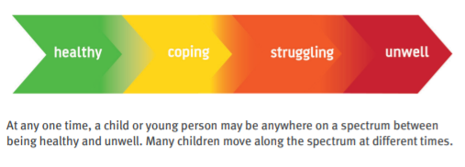
Case study

Slide 20
Alex Davies

Slide 21
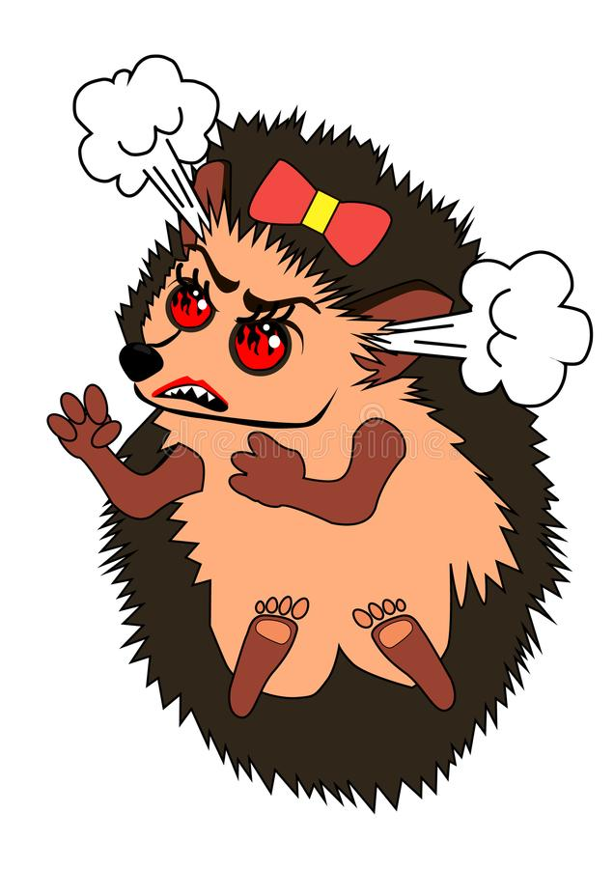
Sarah (not real name)
Joined a SV school in Year 10
High Prior Attaining student
Sociable
Strong leadership qualities
Verbally and violently abusive to staff
Drug user
Eating disorders
Self-harm
Suicidal thoughts

Slide 22
Warning: Next slide may be triggering for some people…

Slide 23
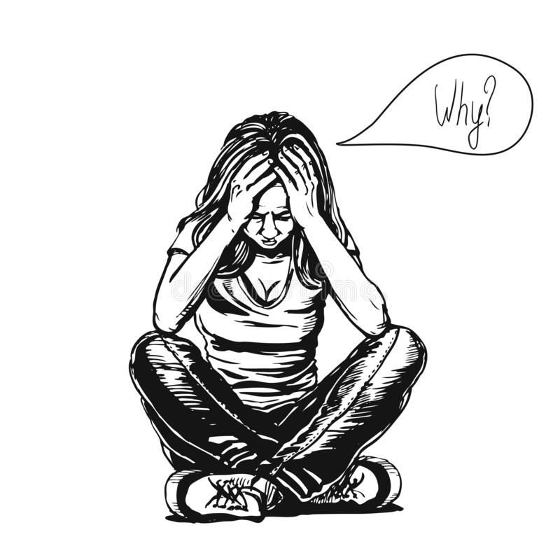
Her story…
Mum was a heroin addict
Struggled in school
Went to 5 schools before coming to SV
Sexual abuse
Sadly this story is not uncommon

Slide 24
YESSSS!
Finished school with 5 qualifications including a 7 in Art, 5 in English and a 5 in maths
Is working full-time
Still in regular contact with the school

Slide 25
Strategies we used…
Emotionally available adult
Triangle of support
Mindfulness/Well-being walks
Anger management
Therapy
Art
Bespoke curriculum
Never giving up
1.1 line management (well-being top of the agenda)
Clinical supervision for staff

Slide 26
Time to Think about our Girls…
What are their behaviours really communicating?
How are we supporting their mental health?

Slide 27
Early signs of poor mental health
tearfulness
tiredness and lack of energy
sleeping more or less
talking less and avoiding social activities
talking more or talking very fast, jumping between topics and ideas
finding it difficult to control your emotions
drinking more
irritability and short temper
aggression
Some early signs of poor mental health might be:
poor concentration
being easily distracted
worrying more
finding it hard to make decisions
feeling less interested in day-to-day activities
low mood
feeling overwhelmed by things

Slide 28
Sampson (Not real name).
Calm, pleasant, confident
No identified SEND
GDS reading, writing and maths, loved mathematical problem solving.
Years 5&6
Angered easily.
Outspoken - loud outbursts.
Found problem solving increasingly difficult, did not want to reason. Wanted right/wrong.
Refused to write. Would type.
Behaviour incidents.
Family where males did not talk about feelings.
Withdrawn, head down, hoody up.

Slide 30
4. Reading /Lone Journal reflection task (5 minutes)
Reflect on what you have heard.
What are their barriers to good mental health?
What could be done to support them?
Remember this if you aren’t a trained counsellor, what can you be doing?

Slide 31
5. Breakout rooms – sharing barriers/solutions (8 minutes) What barriers and solutions have you discussed? Add to your list and notes above considering the views of others.

Slide 32
6. Coming back together for feedback/next questions (5 minutes)

Slide 34
Chat feedback and next steps together ‘compelling action’ (2 mins). Add to your list and notes above considering the views of others. List below what you will now do as a result of this discussion:

Slide 35
34
Reflection | The impact of this PD | From knowing to doing
What impact will this have on your teaching?
What impact will this have on your pupils?
What is your main takeaway from this session?

Slide 36
Thank you for your contributions

Slide 37
Wellbeing can be described as judging life positively and feeling good.
https://www.cdc.gov/hrqol/wellbeing.htm

Slide 38
Delivering high quality primary mental health care
Ensuring that individuals with severe and enduring mental illness have a care plan which meets their specific needs, including access to services round the clock
Providing safe hospital accommodation for individuals who need it
Ensuring that everyone who has a mental health problem can contact local services.
Promoting mental health for all

