Slide 1
ECT Launch Pad
Session 4 – Classroom Practice 1
Chris Baker
CLF Professional Development Lead
Chris.baker@clf.uk

Slide 2
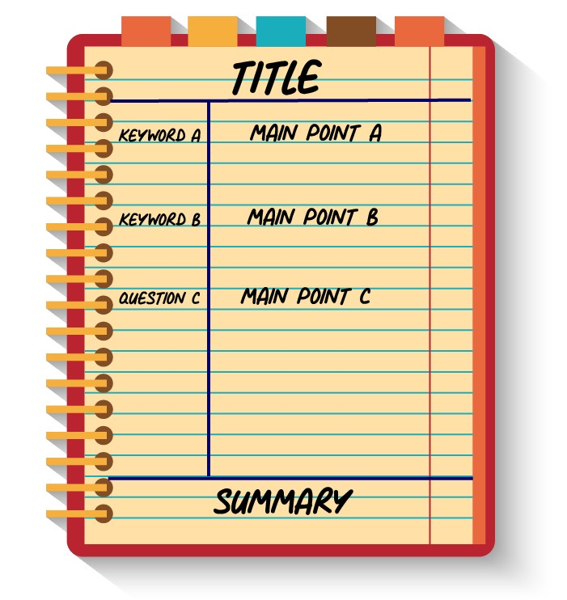
Note Taking
Separate your page into the four sections as per the image below;
2. In the large right-hand column of your paper, take notes like you normally would (text, diagrams etc) Leave spaces to separate themes or topics;
3. In the left-hand column, create questions about your notes. These questions should prompt your recall and understanding of the content. (Why, How…);
4. The left-hand column can also be used for, key terms, people, events, dates etc;
5. When finished with each page, use the bottom section to write a 2-3 sentence summary of your notes.

Slide 3
Agenda
Learning Environment
Exposition
Modelling

Slide 4
Pre-Reading
Learning Environment
Exposition
Modelling

Slide 5
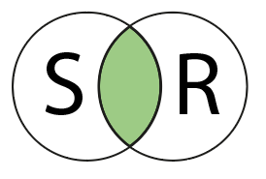
Learning Environments
For good or for bad
we are products of
our environment
Environmental conditions precede feelings and behaviours
Normative messaging build culture
You promote what you permit
Effective environments are difficult to develop but easy to see
Every action either builds or erodes your desired environment

Slide 6
Learning Environments
Seating for Learning
Positive Language
Explicit ethos / values
Useful Displays
Modelled Behaviour
Positive
Safe
Respectful
Celebratory
Challenging
Effort over outcome

Slide 7
Describe the learning environment you hope to create using ONE of the sentence starters below:
Finish
1
2
3
4
5
Extension Activity:
What three words do you hope people use to describe your learning environment?
In my classroom
students feel…
They experience …
Visitors will see ...

Slide 8
Pose
What will you do on a daily basis to maintain an effective learning environment?
Pause
Pair
Pounce
Bounce

Slide 9
Questions & Summary
Why does…?
What if…?
The golden nuggets for me were

Slide 10
Break
Finish
1
2
3
4
5

Slide 11
Agenda
Learning Environment
Exposition
Modelling

Slide 12
Exposition
Learning starts with information processing
Issues during the input stage negatively affect processing
Processing success is a joint venture
Clarity in the sender’s mind does not guarantee it at the other end
Poor or incorrect processing is hard to correct.

Slide 13
Exposition
Clear Explanations
Logical Instructions
Inclusive language
Optimal length
Effective tone / volume
Break material down into steps / chunks;
Explicitly link to prior learning;
Remove cognitive distractions;
Combine verbal and visual;
Use analogy, example and non-example.

Slide 14
Select a topic in your subject / specialism and break it into logical sub-topics or steps.
Finish
1
2
3
4
5
6
7
8
9
10
Extension Activity
Which topic precedes and follows your chosen topic
Topic
Step
Step
Step
Step
Step

Slide 15
Pose
What unconscious verbal ticks have you developed?
Pause
Pair
Pounce
Bounce

Slide 16
Questions & Summary
Why does…?
What if…?
The golden nuggets for me were

Slide 17
Break
Finish
1
2
3
4
5

Slide 18
Agenda
Learning Environment
Exposition
Modelling

Slide 19
Modelling
Resistance is often
just a lack
of clarity
It is difficult to plan without a destination in mind
Knowing if you have arrived is hard with a desired destination
Checking progress more difficult without milestones
Anxiety and uncertainty reduce cognitive performance

Slide 20
Modelling
Time protected
Student & Teacher Led
Purposeful
Efficient
Responsive
Part & Incorrect examples
Model outcomes, instructions and processes
Chunk to avoid overload
Narrate thought processes
Expose potential pitfalls and how to avoid
Ask questions aloud for students to consider

Slide 21
Create a part example and an incorrect example specific to your subject / specialism.
Finish
1
2
3
4
5
Extension Activity
What are the key misconceptions with your chosen example?

Slide 22
Pose
What are the common errors with teacher modelling?
Pause
Pair
Pounce
Bounce

Slide 23
Agenda
Learning Environment
Exposition
Modelling

Slide 24
Questions & Summary
Why does…?
What if…?
The golden nuggets for me were

Slide 25
Next Session
Friday 28th August
Questioning – LINK Responsive Teaching – LINK Feedback – LINK
Pre-Read
How much of your student’s work is demonstrably better because of your feedback?
Could you find examples of Before & After feedback?
Reflect
Extend

